Slide 1
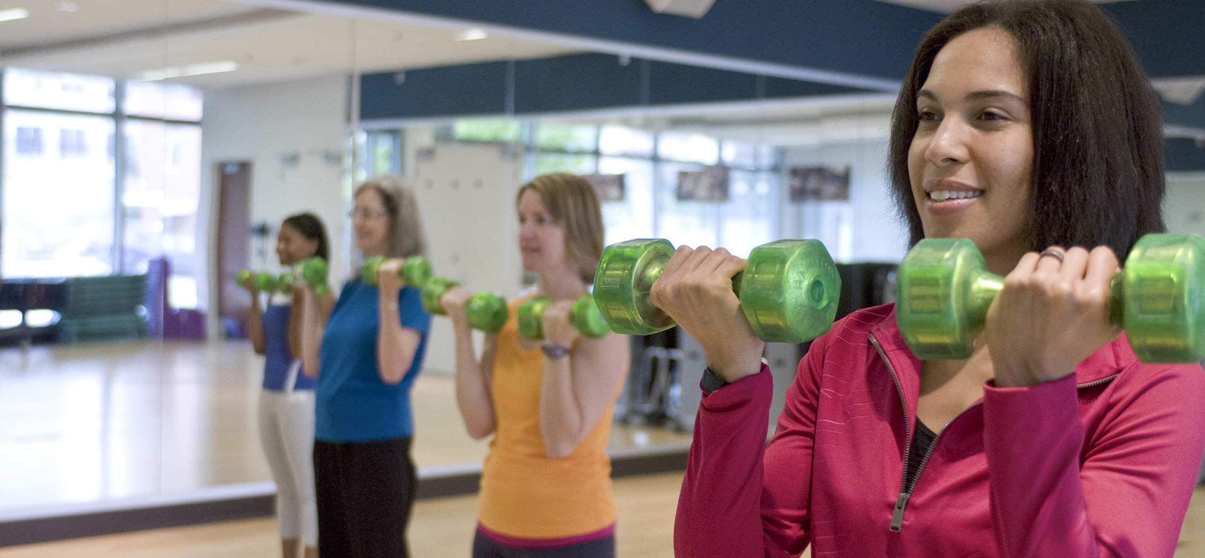
Sunflower Wellness Exercise Classes

Slide 2
Sunflower Wellness Exercise Classes

